Slide 1
Kiran Franklin G
Senior Research Associate, Excelra
18th Sept 2023

Slide 2
Outline
Education background and projects
Research paper discussion

Slide 3



Education background and projects
B.E Biotechnology
2017 – 2021
Dayananda Sagar College of Engineering,
Visvesvaraya Technological University
CGPA : 8.99
Awards:
Participated and won 1st prize for paper presentation in international conference” HORIZON 2019.
Internships
Intern, Shodhaka Life Sciences
Jun ‘19 - Aug ’19
Research Intern, Bayes Labs
Jun ‘20 - Oct ’20
AI Master Class, Pantech Solutions Pvt Ltd (Pantech ProLabs India) · Apprenticeship
Oct ‘20 - Nov ’20
Skills:
TensorFlow · TensorBoard · Data Science · Machine Learning · Matplotlib · NumPy · Seaborn · Python (Programming Language) · MS Excel
· Bioinformatics · CADD · MMDD
Projects
Insilco study on human delta sarcoglycan protein involved in Limb Girdle Muscular Dystrophy.
Functional impact on G108R mutations in PPT1 causing infantile neuronal ceroid lipofuscinosis: A molecular dynamics Study
Enzymatic and antibiotic degradation of Bacterial biofilm in Ventilator Associated pneumonia.

Slide 4
Education background and projects
Bioinformatics Engineer
Boltzmann labs
Mar, 2021 - Jun, 2022
Projects
Automated cheminformatics data-scraper-curator and QSAR modelling.
Automated virtual Screening and Validation of Small molecules: ADMET and Molecular docking.
Chemical space exploration and surrogate modelling.
Led a team of 6 in conducting internal and external case studies.
Open Souce contribution MolPro
Skills:
Scikit-Learn · Microsoft Visual Studio Code · Pycaret · Team Management · Data Science · Machine Learning · Matplotlib · NumPy · Bioinformatics · Python (Programming Language) - GCP
· Bioinformatics:
· Libraries – Rdkit, pubchempy, chembl_webcleint, Biopython, PLIP .
· Utilizing traditional and AI CADD tools such as playmolecule, Boltchem. Building similar tools.

Slide 5
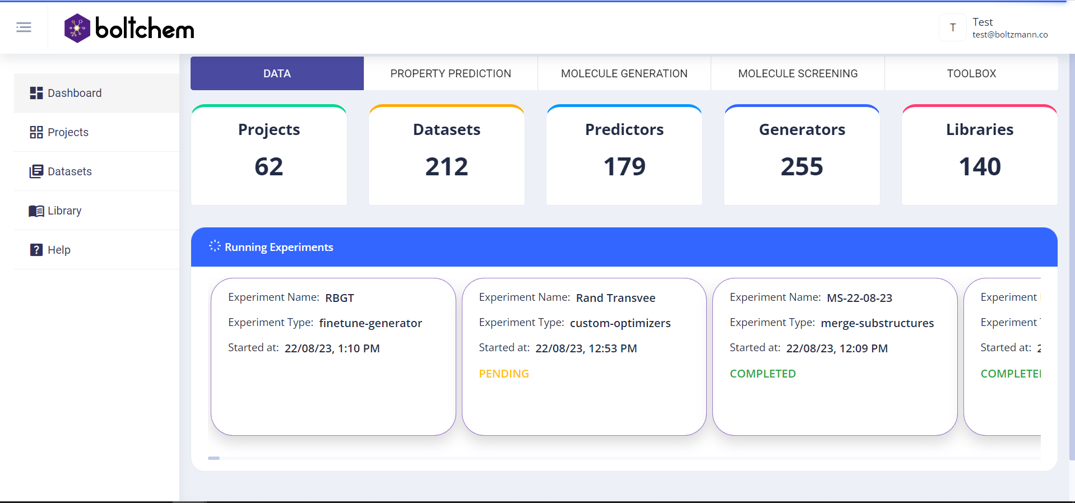
BoltChem : AI powered platform developed with data driven approaches and emphasis on multi objective optimization.

Slide 6
Education background and projects
Senior Research Associate
Excelra
Jun 2022 – Present
.
Awards:
Outstanding Employee Award, Mar. 2023
Projects
SaaS for HTOmics.
Designing SaaS platform for Impurity management and toxicology reports.
Migration of Analytics ready pipeline.
Skills :
PostgreSQL · SQL · GitHub · Docker · Data Engineering · PyTest · Google Cloud Platform (GCP) · Nextflow · Python (Programming Language) · Flask · React.js · pyspark
· Bioinformatics · RNA-Seq Analysis using DESeq2, GAGE, clusterprofiler, David · Learning scRNA-seq - scanpy

Slide 7
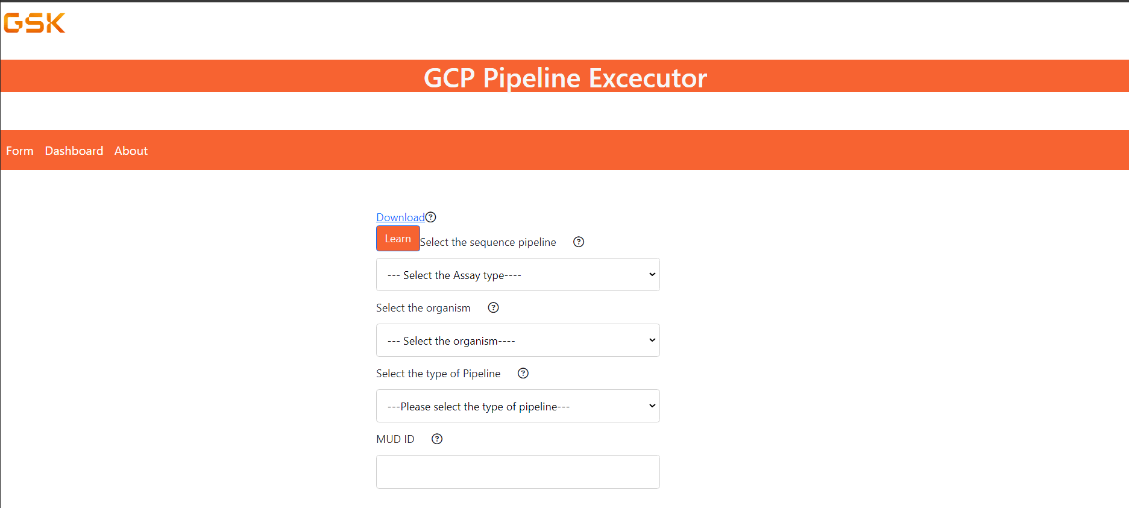
SaaS Omics platform

Slide 8
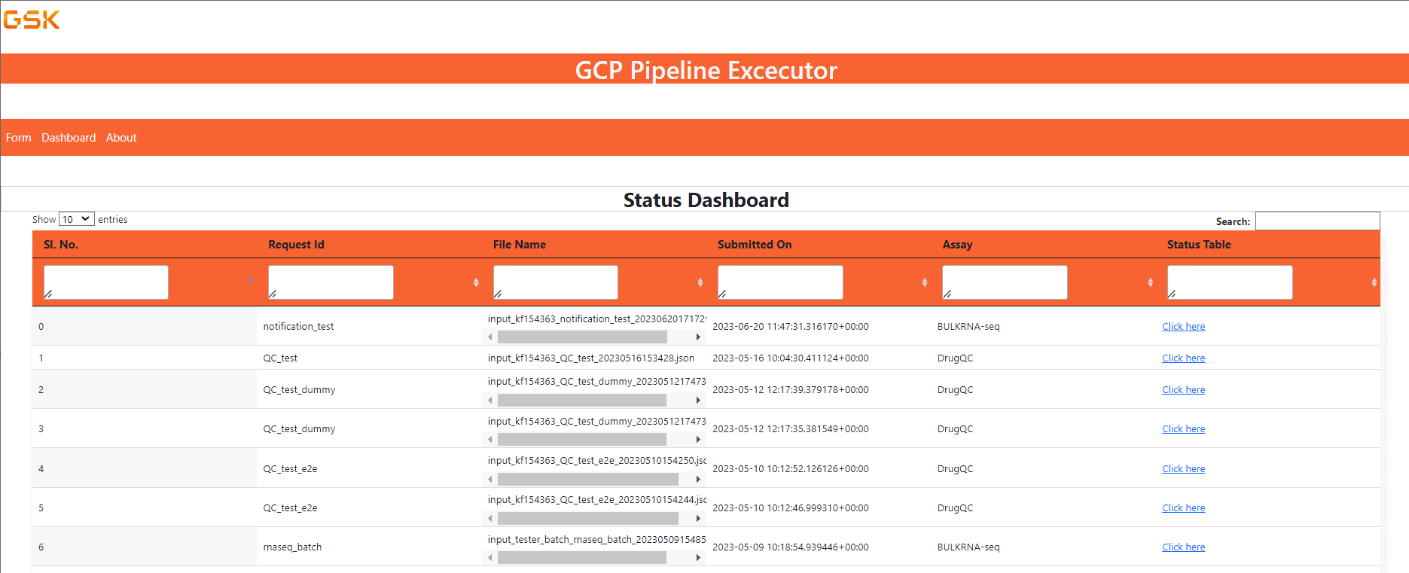
SaaS Omics platform

Slide 9
Thank you

Slide 10
Back-up

Slide 11
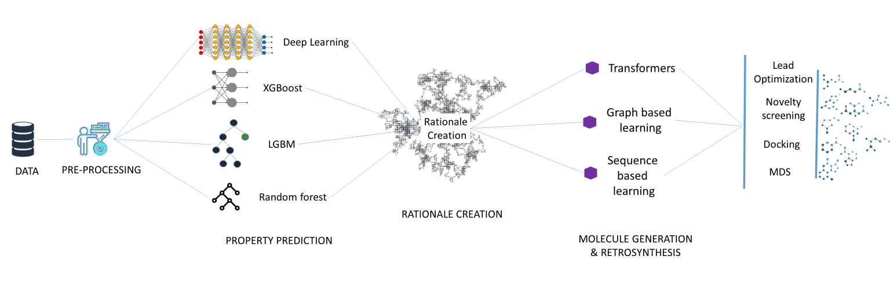
BoltChem : AI powered platform developed with data driven approaches and emphasis on multi objective optimization.
git remote set-url origin

Slide 12
Systems and methods:
Insilco study on human delta sarcoglycan protein involved in Limb Girdle Muscular Dystrophy.
Uniport
Protpram
Sopma,Jpred, PredictProtein, MeMe & ConSruf
String
I-Tasser
DAG1 wild type & mutant
HADDOCK
PDBSum
Analysis

Slide 13

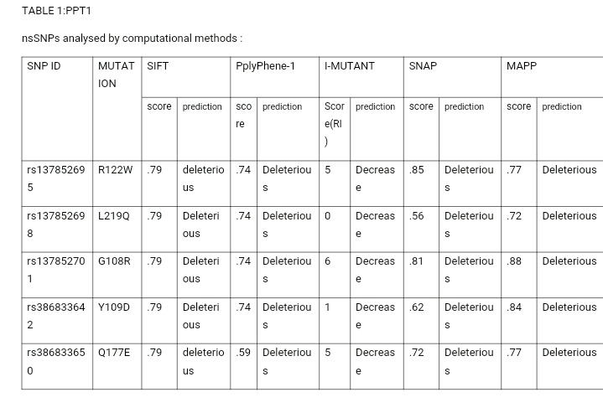
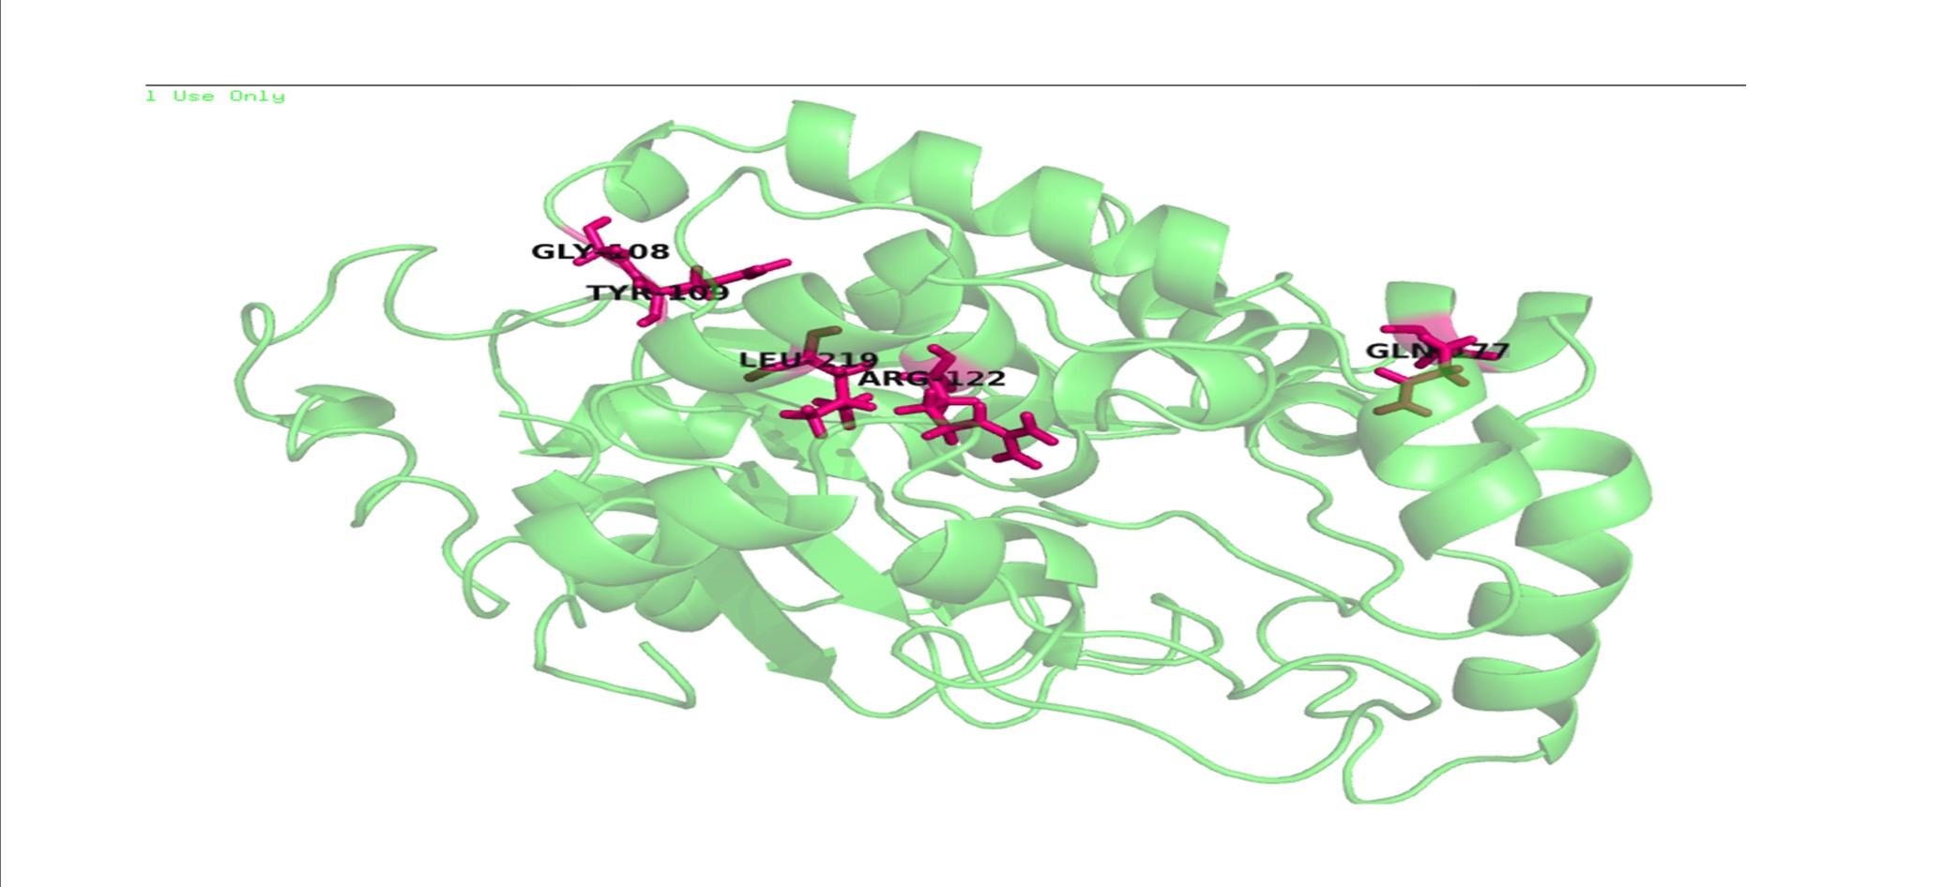
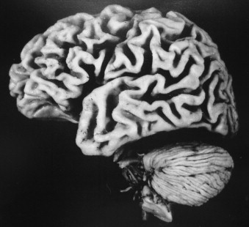
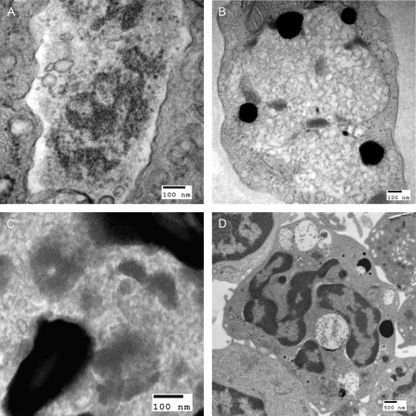
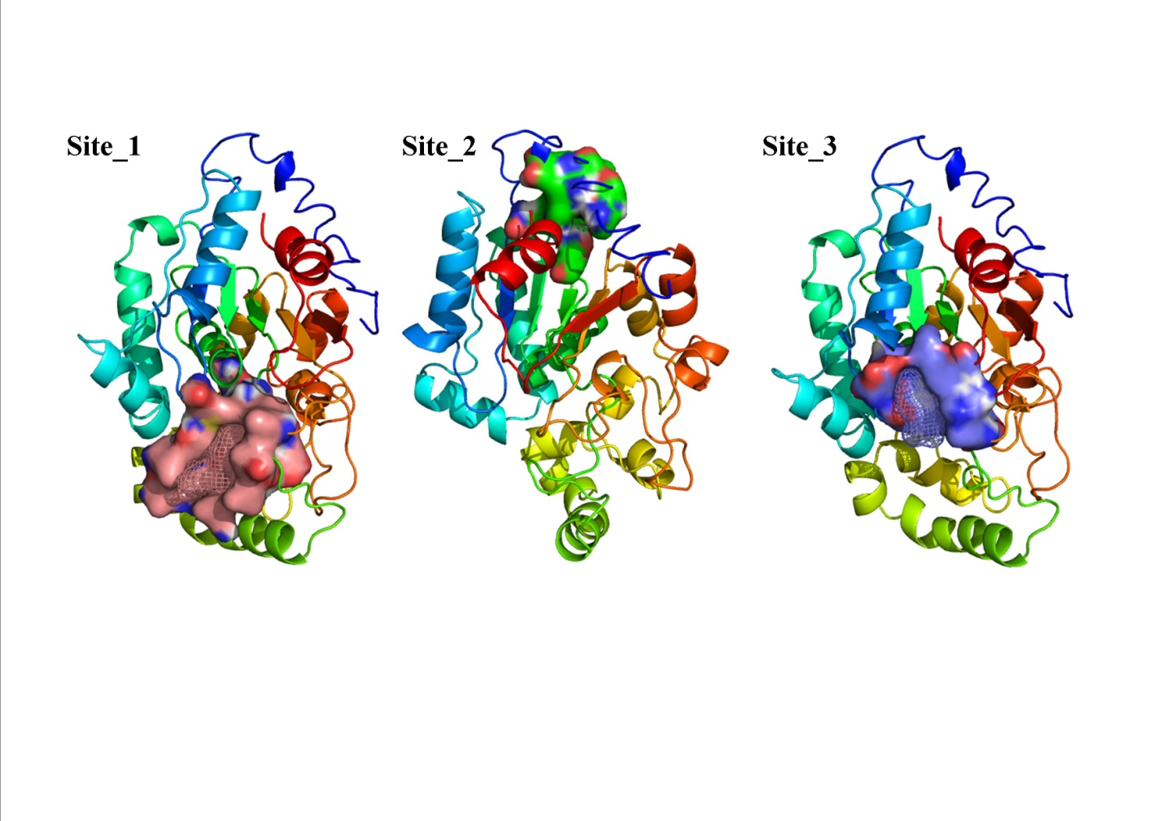
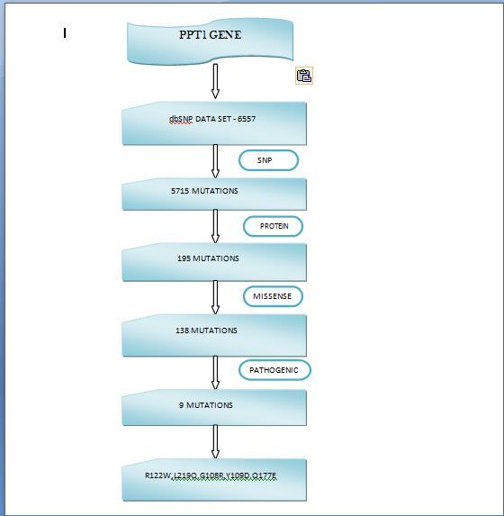
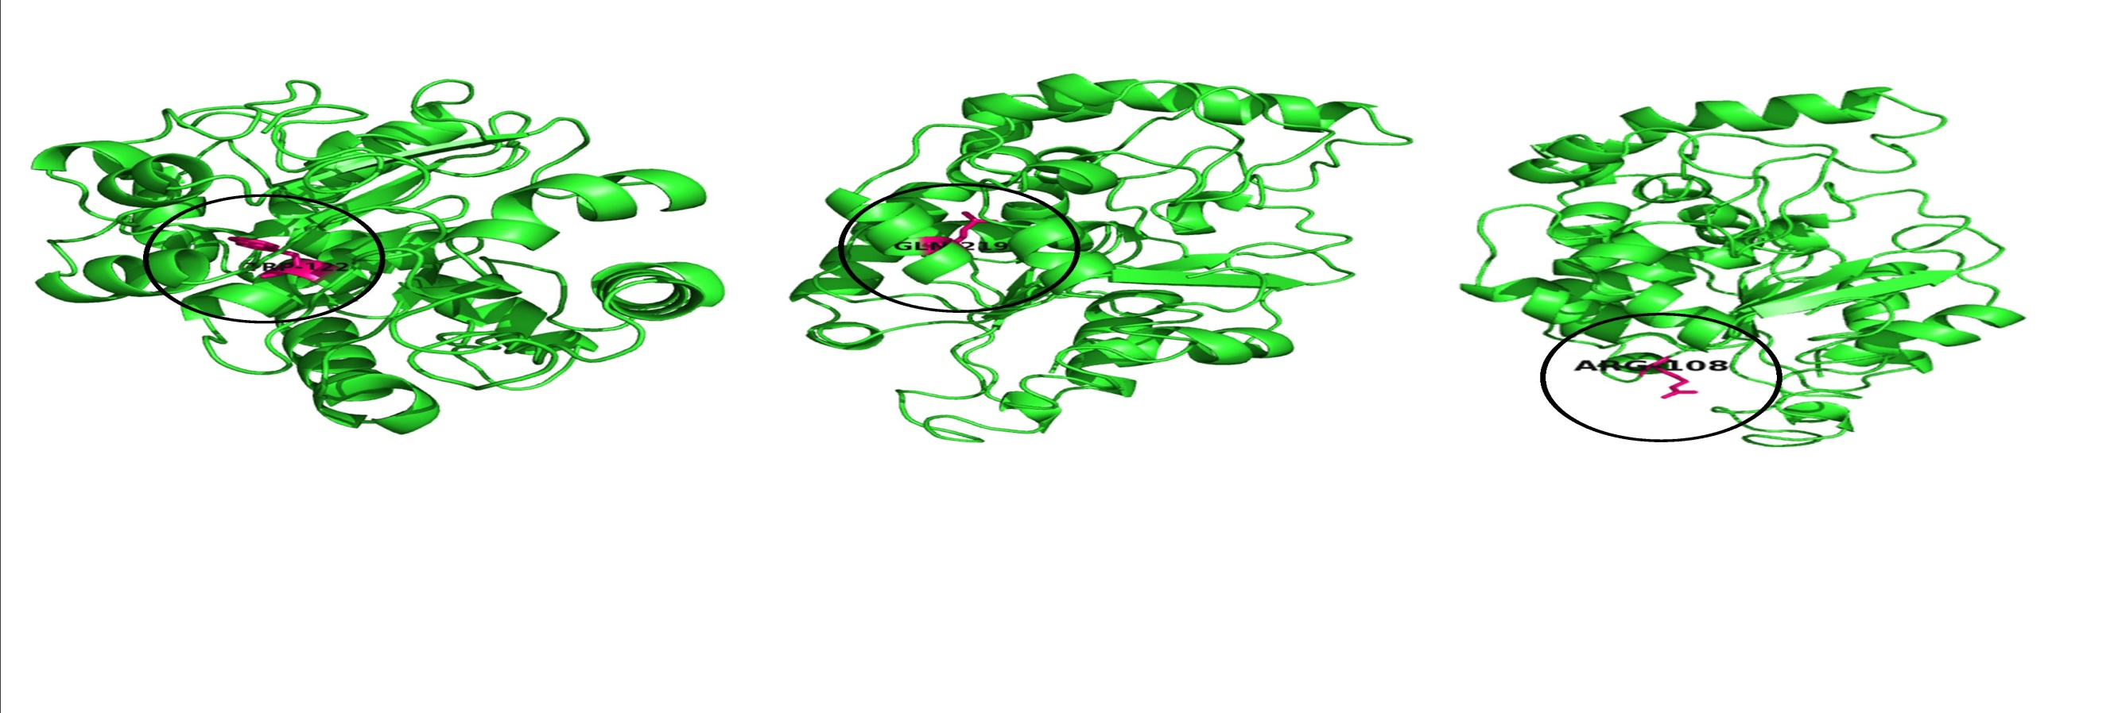
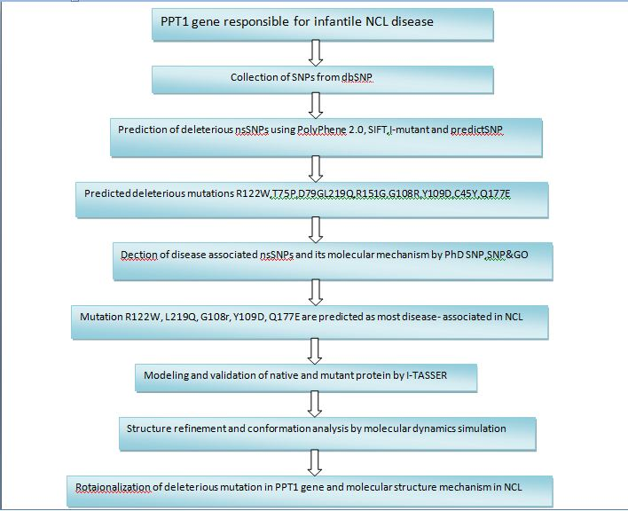
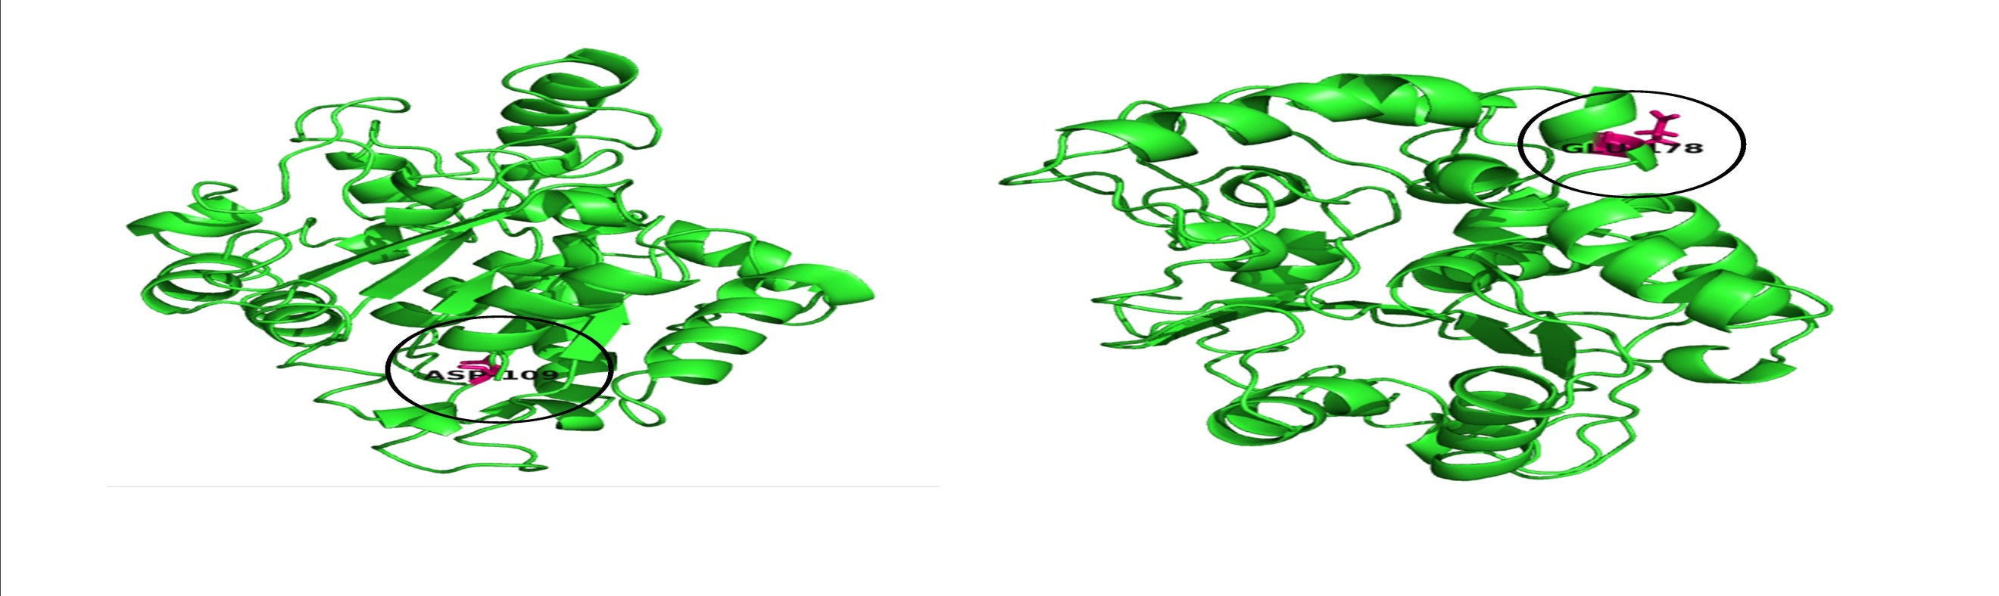
Sequential and structural studies on mutations in palmitoyl-protein thioesterase 1 (PPT1) causing infantile neuronal ceroid lipofuscinosis
REPLACE THIS BOX WITH YOUR ORGANIZATION’S
HIGH RESOLUTION LOGO
Kiran Franklin G, Yaswanth.R, K.M.Kumar*
ABSTRACT
INTRODUCTION
RESULTS
DISCUSSION
ACTIVE SITES:
MUTATION OF PPT1:
NCL1 is also called an infantile neuronal ceroid lipofusionosis (INCL), occurs due to functional changes of the enzyme palmitoyl-protein thioesterase 1 (PPT1) due to mutation in the PPT1 gene. PPT1 is a lysosomal long-chain fatty acyl hydrolase that removes fatty acyl groups from modified cysteine residues in proteins. Mutations in PPT1 protein were late found to cause infantile neuronal ceroid lipofuscinosis, a disease characterized by accumulation of amorphous granular stores in cortical neurons, prompting to blindness, seizures, and brain death by the age of three. In the present study, we obtained 9 missense mutations from dbSNP databases and applied series of comprehensive insilico screening methods to assess the degree of pathogenicity and stability. Screening of mutation is done using various filtering options like structural annotation, Missense and likely pathogenic. Finally from the Insilico screening, we found five missense mutations (R122W, L219Q, G108R, Y109D, and Q177E) to be potential disease causing mutations. These five mutations are further analysed structurally and functionally using various proteomics tools. The proposed study may provide a platform for personalized medicine for diseases that are caused by the PPT1 deficiency
*Neuronal ceroid lipofuscinosis (NCL) disorder is a family of at least eight genetically inherited lysosomal neurodegenerative diseases that result from excessive accumulation of autofluresecent lipopigments (lipofuscin) in the body's tissues.
*The clinical course of NCL includes progressive dementia, pro­gressive visual failure, seizures and often movement abnormalities.
*There are several forms of NCL, largely differentiated by the gene responsible and the age at which symptoms begin. Mutations in the PPT1 gene typically result in the infantile or juvenile form of NCL.
*There is no treatment for the underlying cause of NCL.
*Various medications can be useful for treating seizures, poor muscle tone, sleep disorders, mood disorders, excessive drooling, and digestion.
*The prognosis for a person with NCL depends upon the type of the disease he or she has. People with INCL or JNCL will become blind and will deteriorate mentally. They will eventually enter a vegetative state and become totally dependent on others to care for them. Among those with INCL, death usually occurs in childhood
WILD TYPE:
Figure 1.BRAIN OF INFANT VICTIM
OF NCL 1
Figure 2. OVERVEIW OF PPT1 .
CONCLUSIONS
METHODS AND MATERIALS
The enforced expression of the wild type ppt1 , results in infantile NCL/CLN1 disease. This mutation causes the decrease or elimation of enzyme PPT1 which is the active component of lysosomes. Our results shows that mutation at the five majors sites (R122W, L219Q, G108R,Y109D, Q177E) effects the stability in PPT1 gene .Results also suggests that these mutation are disease related. The MD simulation results show that this mutation are invovled in the increment of the stability of PPT1 gene , which gives the reverse conclusion that was previously proved . We then checked the protein aggregation which showed the misfolding and resulted in protein malfunction . Our results strongly conclude that the mutation in PPT1 increases the stability of the protein and exhibits a protein aggregation that leads to loss of its function.
DATA MIING OF PPT1 GENE:
Gg
Method and materials:
REFERENCES
CONTACT
<your name>
<organization name>
Email:
Phone:
Website:

Slide 14
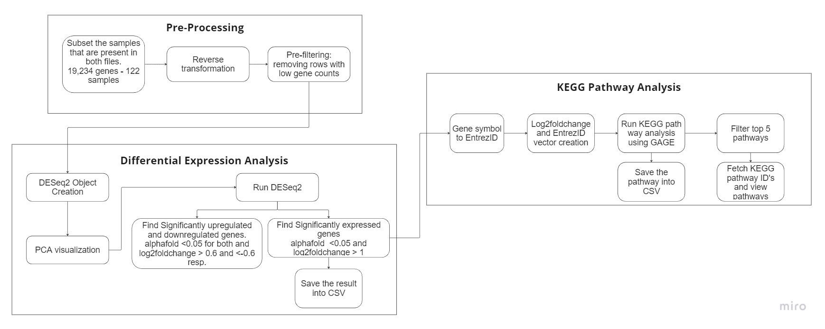
Differential gene expression analysis problem workflow

Slide 15
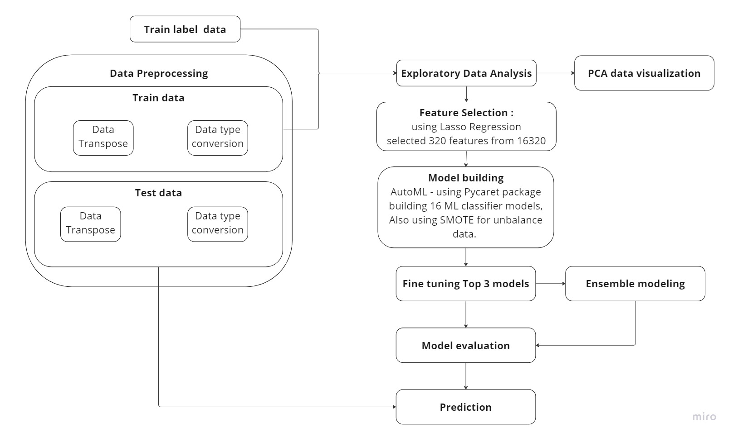
Predicting Cancer Types from Gene Expression Data: A Machine Learning Approach

Slide 16
Education background and projects
B.E Biotechnology
2017 – 2021
Dayananda Sagar College of Engineering,
Visvesvaraya Technological University
CGPA : 8.99
Awards:
Participated and won 1st prize for paper presentation in international conference” HORIZON 2019.
Bioinformatics Engineer
Boltzmann labs
Mar, 2021 - Jun, 2022
Senior Research Associate
Excelra
Jun 2022 – Present
Awards:
Outstanding Employee Award, Mar. 2023.
Intern, Shodhaka Life Sciences
Jun ‘19 - Aug ’19
Research Intern, Bayes Labs
Jun ‘20 - Oct ’20
AI Master Class, Pantech Solutions Pvt Ltd (Pantech ProLabs India) · Apprenticeship
Oct ‘20 - Nov ’20
Insilco study on human delta sarcoglycan protein involved in Limb Girdle Muscular Dystrophy.
Functional impact on G108R mutations in PPT1 causing infantile neuronal ceroid lipofuscinosis: A molecular dynamics Study
Enzymatic and antibiotic degradation of Bacterial biofilm in Ventilator Associated pneumonia.
Skills:
TensorFlow · TensorBoard · Data Science · Machine Learning · Matplotlib · NumPy · Seaborn · Python (Programming Language) · MS Excel
· Bioinformatics · CADD · MMDD
Automated cheminformatics data-scraper-curator and QSAR modelling.
Automated virtual Screening and Validation of Small molecules: ADMET and Molecular docking.
Chemical space exploration and surrogate modelling.
Led a team of 6 in conducting internal and external case studies.
Open Souce contribution MolPro
Skills:
Scikit-Learn · Microsoft Visual Studio Code · Pycaret · Team Management · Data Science · Machine Learning · Matplotlib · NumPy · Bioinformatics · Python (Programming Language) - GCP
· Bioinformatics:
· Libraries – Rdkit, pubchempy, chembl_webcleint, Biopython, PLIP .
· Utilizing traditional and AI CADD tools such as playmolecule, Boltchem. Building similar tools.
SaaS for HTOmics.
Designing SaaS platform for Impurity management and toxicology reports.
Migration of Analytics ready pipeline.
Skills :
PostgreSQL · SQL · GitHub · Docker · Data Engineering · PyTest · Google Cloud Platform (GCP) · Nextflow · Python (Programming Language) · Flask · React.js · pyspark
· Bioinformatics · RNA-Seq Analysis using DESeq2, GAGE, clusterprofiler, David · Learning scRNA-seq - scanpy

